Slide 1
Nils-Olov Lindfors, Regional Councilor, Norrbotten County Council

Slide 2
The climate benefit of the Swedish forest
In what way can the Swedish forest contribute to a counteraction of the increased greenhouse effect ?

Slide 3
The Swedish forest
23,6 million hectares of production forest, corresponding to
55% of the land area.
Pine 40%, Spruce 41%, Birch 13% of the growing stock
Annual average growth is 5,3 m³/ha (3,2 - 7,3)
Total annual growth is about 120 million m³
- a 50% increase since 1970.
Total annual cut is 90 million m³
Total growing stock is 3100 million m³
- a 50% increase since 1970
Annual growing stock increase is about 1%
Notes:
Statistik

Slide 4
Forest CO₂ sequestration during 75 years
Ågren et. al. 2007
Skogsstyrelsen
Skogsstyrelsen
Notes:
1926 the amount of carbon in soil and trees was 3,4 and 2,2 billion tonnes CO2, respectively, together 5,6
75 years later, these amounts had increased by 0,5 to 3,9 and by 1,5 to 3,7 billion tonnes = 7,6 billion tonnes
During the same period, 4,3 billion m3 stem wood were harvested, corresponding to 3,3 billion tonnes of captured CO2
Total CO2 capture was 5,3 billion tonnes CO2
The annual CO2 capture was 70 million tonnes, more than all greenhouse gas emissions 2005.
Thus, the Swedish forests and forest management has already played an important role in reducing CO2 in the atmosphere, in comparison with the national emissions.
However, the forest potential for mitigating the climate change may be even higher.
Diag 1 Markkol är allt kol oberoende av djup. 50% av kolet I org mtrl bryts ner på 250 år. Modellering av kolet.
4300 milj m3=0.42*4300=1806 ton=1806*0.49=885 ton C=885/0.27=3278 milj ton CO2

Slide 5
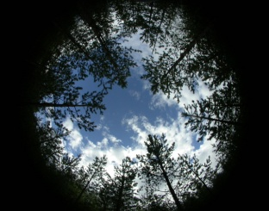
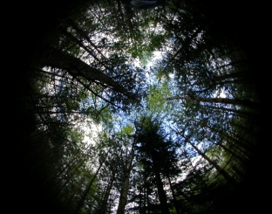
Photosynthesis creates growth
CO₂ + H_{2O} + light energy
Carbohydrates + Oxygen
Increases with increasing
Temperature
Air CO₂ content
Light
CO₂-uptake, %
Leaf area index
Bergh 1997
Kenneth Sahlén, SLU, Inst f skogens ekologi och skötsel
Bergh 1997
Roberntz 1998

Slide 6
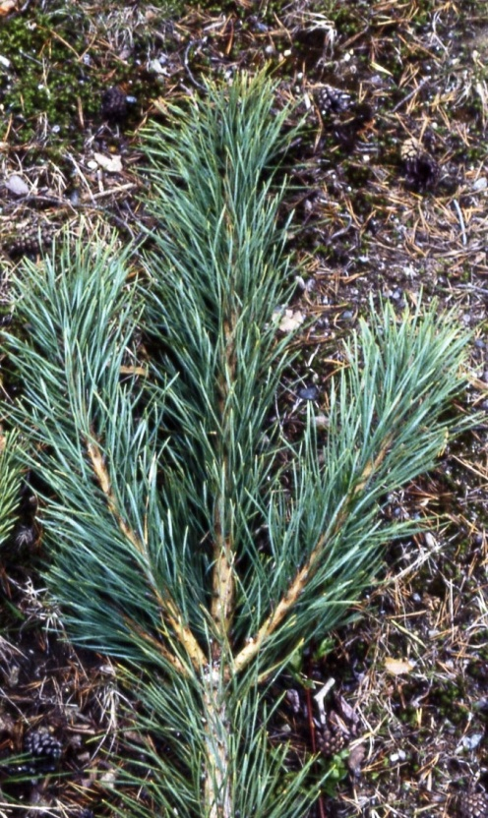
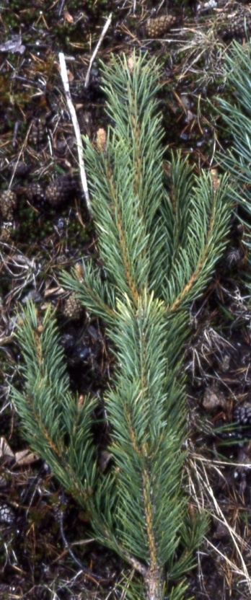
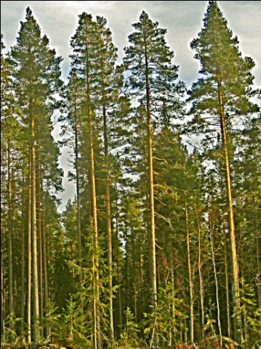
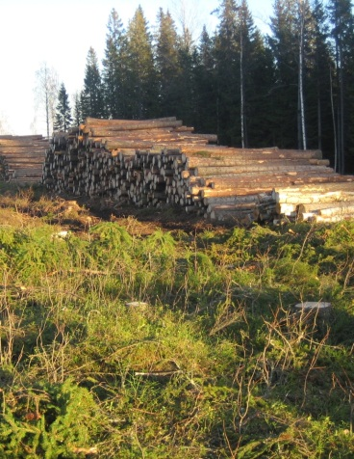
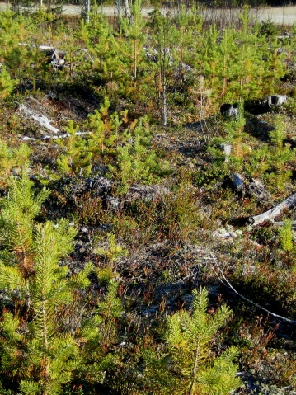
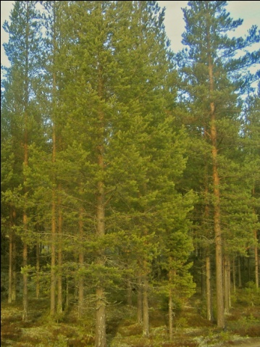
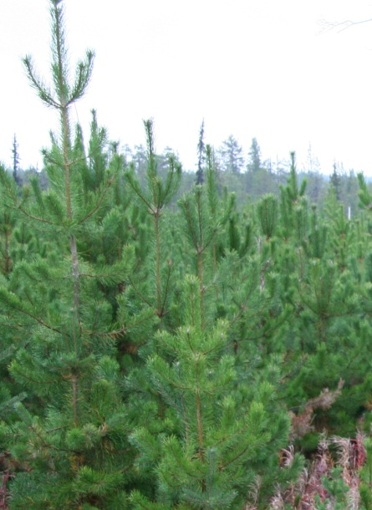
Silviculture for high growth
Rapid regeneration with a high number of plants after final felling
High stem density during the rotation period
Final felling at optimal tree age
Nutrient supply
More needles
= higher photosynthesis
= higher tree growth
Notes:
Growth inreasing forest management is a question about
increasing the needle area throughout the whole rotation.
The period after final cut, without photosynthethiszing
trees should be minimized, by quick regeneration
Regeneration result may be more or less sucessful
If we manage to instead achieve this result, the period of
negative or very low CO2 capture after the final cut, could
be significantly reduced
Stem number/basal area should be kept high also during
the rest of the rotation
In addition, nitrogen nutrient supply would facilitate an
increased production of needles, both in number and size.
So, what is the potential for growth increase and climate
change mitigation in the Swedish boreal conifer forest,
using forest management. Results from two field
experiments give an idea about that.

Slide 7
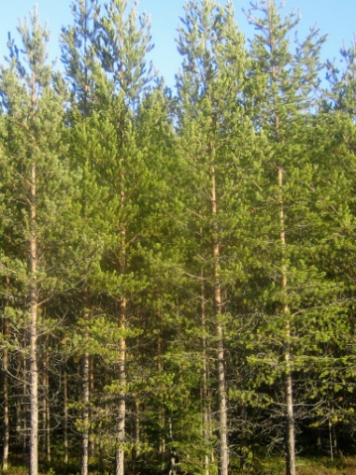
Efter Bergh 1999
Kenneth Sahlén, SLU, Inst f skogens ekologi och skötsel

Slide 8
Long term growth effect
of different forest management practices
Final felling
Years
Notes:
Accumulated growth in the case of no tree biomass harvest
will reach 700 m3 after 300 years.
With ordinary management, tree final cuts with following
replanting will be carried out during the period
Total growth will amount to 1200 m3
With growth increasing management, time between final
cuts is shorter, and the total growth will almost reach 1800
m3, more than double the amount for no management.

Slide 9
Forest management and long term
climate effect
CO₂-sequestration
in trees
Substitution effect,
reduced emissions
Notes:
The total amount of captured CO2/ha for growth increasing
management was 2350 tons/ha, more than double the
amount for no management
Per year between 3,2 and 7,8 tons of CO2/ha.

Slide 10
Forest growth and climate benefit
High growth implies:
- high CO2 uptake from the atmosphere
and
- great supply of renewable tree raw material that may reduce greenhouse gas emissions from coal, oil and natural gas through substitution of raw material that causing such emissions.
High growth and high utilization of forest raw material = great climate benefit
Notes:
The total amount of captured CO2/ha for growth increasing
management was 2350 tons/ha, more than double the
amount for no management
Per year between 3,2 and 7,8 tons of CO2/ha.

Slide 11
How great is the climate benefit of the Swedish forest ?
- the total climate effect of forest, forestry and products/energy based on tree raw material in Sweden, corresponds to about 60 million ton CO₂ ekv. annually in reduced amounts of greenhouse gases in the atmosphere . (Lundmark et al 2014)
- The total greenhouse gas emissions in Sweden 2015 was 53,7 million ton CO₂ ekv.
Are we climate neutral ?
Notes:
The total amount of captured CO2/ha for growth increasing
management was 2350 tons/ha, more than double the
amount for no management
Per year between 3,2 and 7,8 tons of CO2/ha.

Slide 12
Comparison during one forest rotation for Scots pine
After Elfving
Notes:
What would be the effect, if we could apply growth increasing “more needles” management during a whole rotation and lets say increase the average growth during a whole rotation by 50% ?
- Here are the growth curves for the ordinary or standard
practice management. Solid line is average and broken
line is annual growth
- Mean growth for the rotation period is 4 m3, site index
T22, peak annual growth is about 6 m3 and optimal
rotation is 95 years.
Now we add the yellow curves for 50% increased mean growth i e 6 m3, site index T26. Peak annual growth is about 9 m3 and optimal rotation period becomes 20 years shorter. Total growth and harvested wood is 450 m3 after 75 years. At that time the ordinary management production
is 300 m3, which at optimal harvest time 20 years later, has
increased to 380 m3

Slide 13
Without management
Scots pine forest growth without
biomass harvest during 300 years
Annual growth, m³/ha
Years
Notes:
What will happen if we dont manage the forest, and let
nature take care of itself for a 300 year period ? T22
Annual growth peak will occur at 40-60 years, as before.
No final cut is made
Growth will eventually decrease with increasing age and
approaches zero in the very old forest when the tress
become very big and the needle mass is not sufficient for
supply of photosyntate for tree growth
What will be the long time effect on growth and CO2
capture, if we compare the no management scenario with
ordinary and growth increasing management ?

Slide 14
More needles
- light absorption
Increased - CO₂ capture
- tree growth
After Bergh
Notes:
The photosynthetic CO2 capture in a conifer forest
increases with increasing leaf/needle area for light
absorption.
This is shown on the pictures, where less of the sky is
visible from the ground in a dense forest
CO2 capture increase is highest in this area, reaching
maximun level here, after which leaf area may still
increase a lot.
In a dense spruce forest, leaf area may be as high as 12
times the ground area.
So, with more needles, we achive a higher light
absorption and CO2 capture, resulting in increased tree
growth

Slide 15
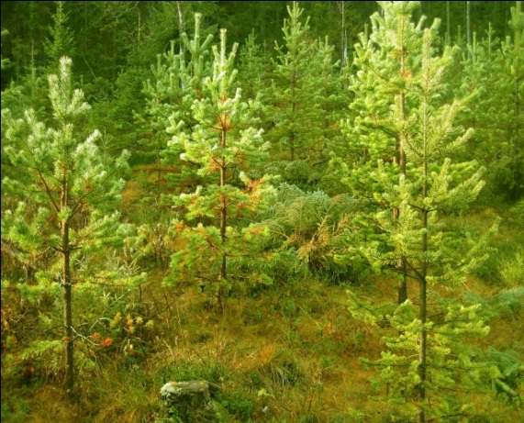
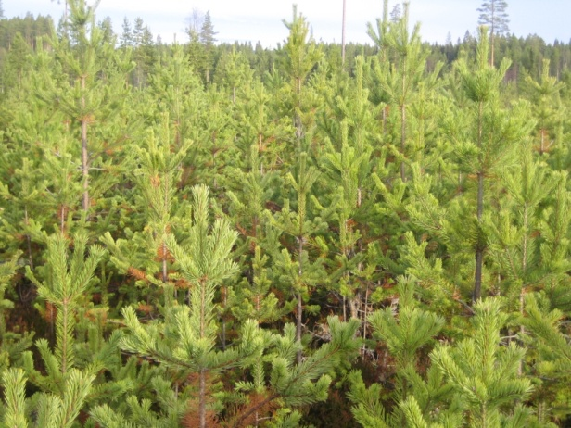
More trees
and
Nutrient
More Needles
Kenneth
Notes:
Hur kan vi åstadkomma mera barr och därmed öka koldioxidbindningen i skogen ?
Vi kan se till att vi har flera träd så får vi mera barr.
För att bygga upp barr går det framförallt åt kväve.
Om man tillför kvävehaltig växtnäring kan träden producera fler och större barr.
. Så flera träd och näring ger mera barr.

Slide 16
Notes:
Från skogsstyrelsen SKA03

Slide 17
Accumulated tree growth
Notes:
Ståndortsindex T 22
Traditionell skötsel innebär slutavverkning efter 100 och 200 år
Tillväxtoptimerad skötsel innebär 25% ökad tillväxt under rotation 1, slutavverkning vid 85 år, 50% tillväxtökning under rotation 2-4, och slutavverkningar vid år 165 och år 245.

Slide 18
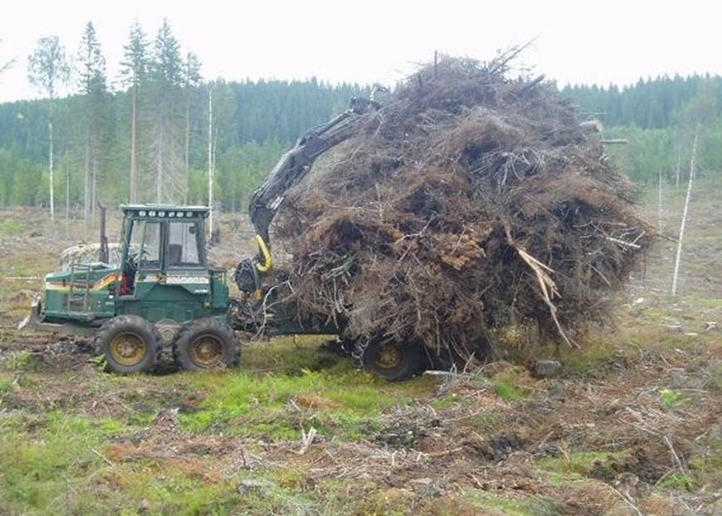
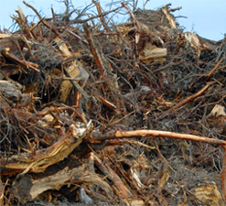
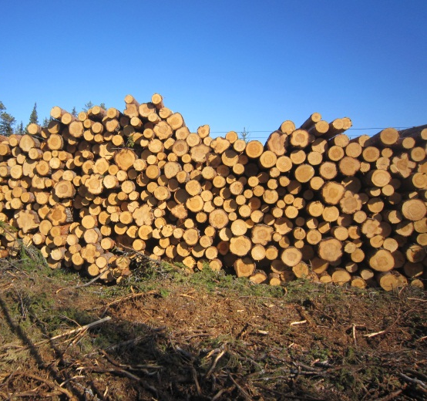
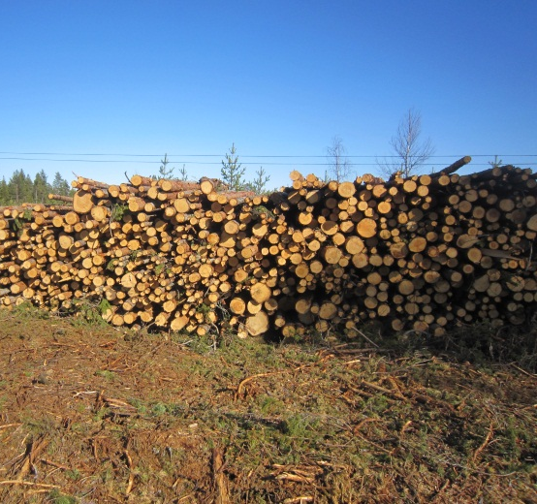
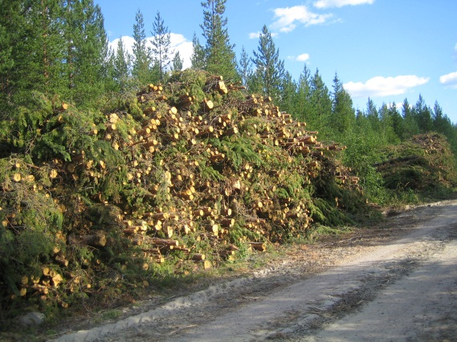
Growth increasing manage-ment,total harvested tree biomass/ha during a rotation
20 t dw
30 t dw
71 t dw, 41 %
71 t dw, 41 %
30 t dw, 17 %
Notes:
With growth increasing forest management, the total produced stem volume will be 450 m3 during the rotation.
Tree biomass is harvested at three occasions, thinnings after 35 and 55 years and final cut after 75 years
At the first thinning, all the above ground biomass of the trees is harvested as fuelwood to an amount of 30 tonnes dw/ha
At the second thinning and final cut, an equal amount of timber and fuelwood is harvested, in total 142 tonnes dw or 370 m³
In addition, at the final cut, logging residues to an amount of 20 t are harvested as well as stumps, in order to utilize the energy content in the biomass, instead of leaving it to decompose and release the captured CO2 to the atmosphere.
In total 222 tonnes/ha of tree biomass is harvested during the whole rotation.
Total tillväxt optimerad =6*75=450 m3, för normal 4 *95=380 m3.
Efter 75 år normal =4*75=300
Det blir 300*1,34 =400 ton CO2.
- i marken 186*95= 17670 kg. efter 75 år 13950 kg C
T26 i marken290*75=21750 kg C efter 75 år
Dividerat med 0.27 blir det CO2 = 51,7 ton CO2 för T22 och 81 ton för T26

Slide 19
Photosynthesis
Carbon dioxide + Water + Light energy
Carbohydrates + oxygen
Kenneth Sahlén, SLU, Inst f skogens ekologi och skötsel

Slide 20
Total sequestration in trees

Slide 21
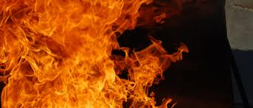
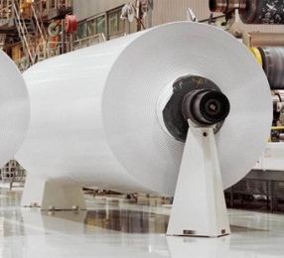
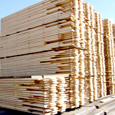
C0₂ effect of tree biomass use
Fuel substitution emission reduction factor = 0,75 kg C /kg C in biomass
Product substitution emission reduction factor = 2,0 kg C/ kg C ”
Reduced emissions, t C/ ha
Fuel Product
Society
carbon pool
23
5
18
14
28
18
70 t C/ha
36 t C/ha
Total emission reduction = 260 t CO₂/ha
or 575 kg CO₂ /m³ harvested stem wood
+ 130 t CO₂/ha or 300 kg CO₂ /m³ added to the society carbon pool
Notes:
What will be the CO2 effect of the tree biomass use ?
Substitution of 1 kg C in fossile based raw material for production of energy or products to 1 kg C from tree biomass, will reduce CO2 emissions with 0,75 and 2 kg C.
Of the tree biomass harvested, 50% will remain in the produced paper and in the produced sawn goods. The rest will be used as fuel. For pulp and paper the rest in form of lignin, black liquor and waste fibre is used entirely within the production process.
80% of produced paper and sawn goods is estimated to end up as fuel and substitute fossile fuels. 80% of sawn goods will substitute other material as steel and concrete, reducing CO2 emissions by 28 tonnes. Totally reduced emissions are 70 t C or 260 t CO2/ha or 575 kg/m3 stem wood.
in addition, the produced paper and tree products, will be part of the society carbon pool for a certain time, befor ending up as fuel or landfill.
in this case, 36 t C/ha is added to this pool.
So, for each inceased m3 in growth, harvest and use, CO2 emissions will be reduced by 575 kg, and 300 kg captured CO2 will be added to the society carbon pool.

Slide 22
Forest management
for climate change mitigation
Conifer forest management for
effective climate change mitigation
means:
increased tree growth and
increased harvest of tree biomass,
facilitating an
increased use of tree biomass for substitution of energy sources and products, based on fossile raw material,
and an
increased society carbon pool of tree based products

